Slide 1

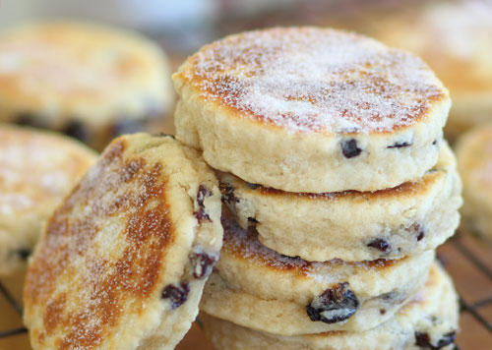

Saint David’s day

Slide 2
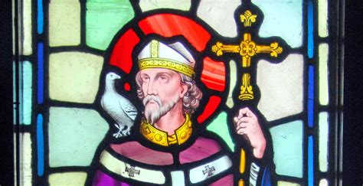
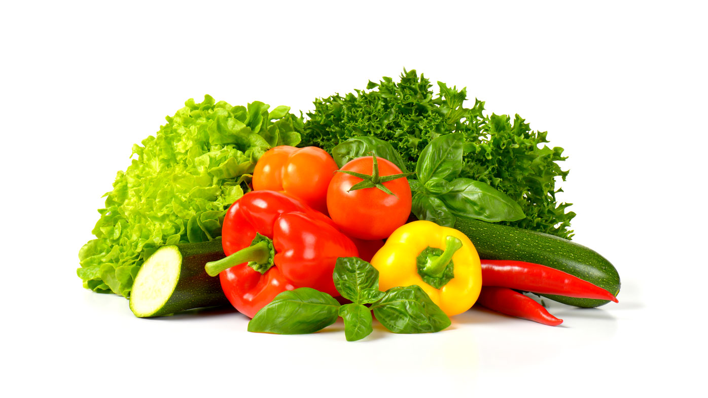

Slide 3
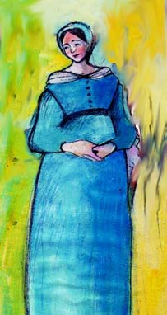
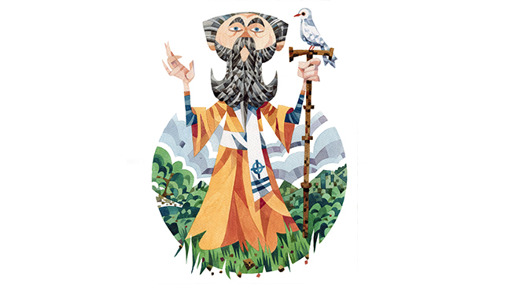

Slide 4
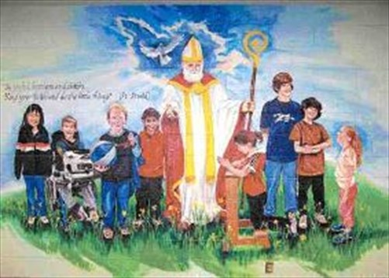

Slide 5

True or False Game
We’re going to pick six people to come and find a carrot in the soil. Read the text then tell us if it’s true or false from what you’ve heard from the story.

Slide 6


